Slide 1


Movie and shows analysis
Data from A IMDB DATASET.

Slide 2

INTRODUCTION…
DID YOU KNOW !!
The highest-rated movie on IMDB has a score of 9.3 out of 10
The average IMDB user watches over 100 movies a year

Slide 3
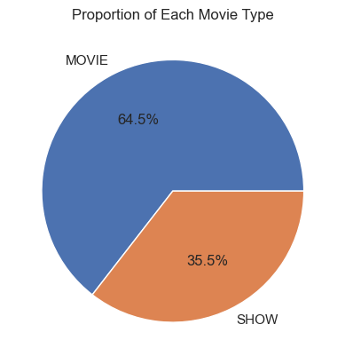
Movies are most watched compared to shows.
Reasons could be:
Shows take a viewer a lot of time to complete.
Movies are straight to the point i.e don’t have a long plot
The production of movies are less expensive than shows thus limiting production

Slide 4
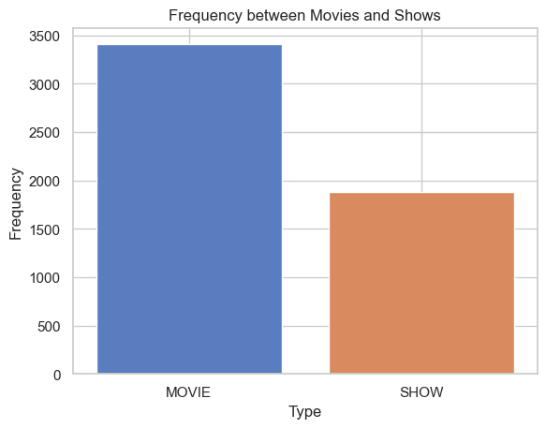
Movies have a high production than shows In film industry
Business case:
The film industry could create platforms or apps where users could have a subscription to access movies and shows at a cost
Entertainment companies, can use this data to gauge market trends and adjust their strategies accordingly.

Slide 5
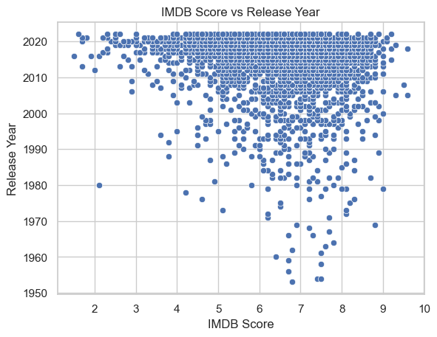
This explains ;
There is an increase in the IMDB score over time, with newer movies/shows
There is an increase of production of movies/shows from 2010 upwards
Some periods show a slight negative correlation between release year and IMDB score, such as around the 1990s.
Business case:
The film industry should adapt its products to changing tastes, as later-released movies are generally preferred..

Slide 6
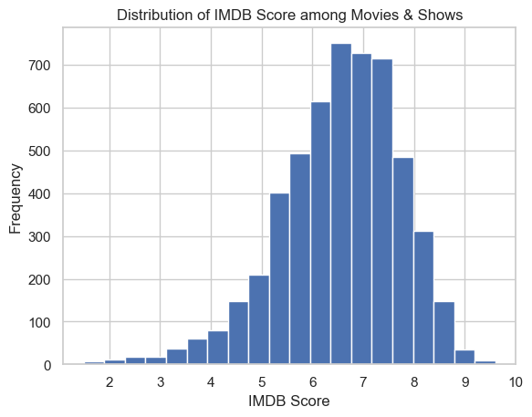
The histogram shows a skewed distribution;
Whereby the mode and median are the most top bar
The 2nd top bar is the mean of imdb score
The imdb score;
Mode, median = 6.5
Mean = 7
Business case:
IMDB scores can guide content curation and distribution strategies, prioritizing high-quality content for premium audiences and distributing lower-quality content to a larger audience, generating revenue.

Slide 7
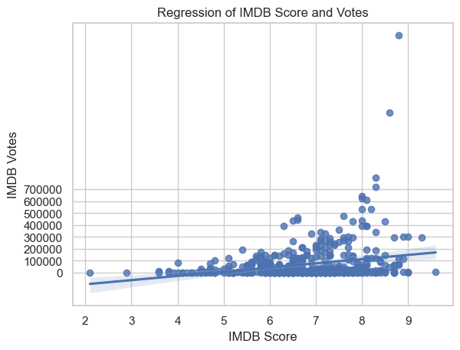
The regression line suggests that the relationship between the number of IMDB votes and the IMDB score is negatively correlated.
Movies with more IMDB votes tend to have higher IMDB scores.

Slide 8
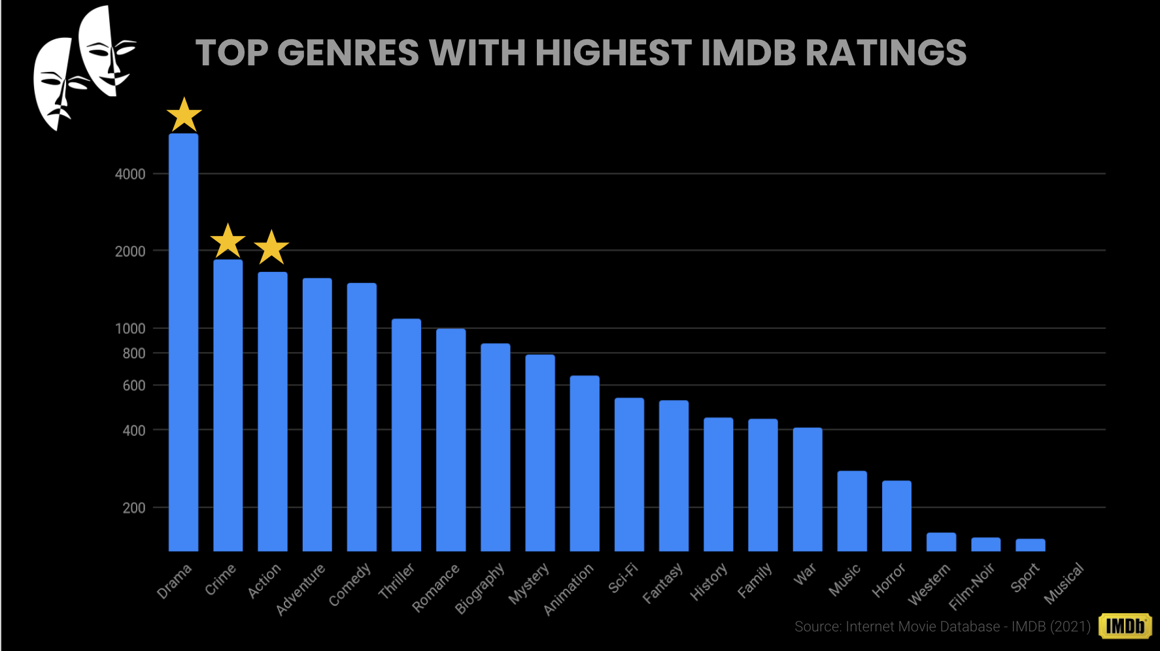

Slide 9

recommendations
Movies rule! Higher production value and audience impact make them a wiser focus for film industries.
IMDB scores says it loud: Focusing on quality films, captivates a large crowd!
Dive into movie data, dominates demographics! IMDB trends fuel savvy product placement, marketing mastery..

Slide 10
Future work
I could involve using the imdb API to Calculate movie-related statistics, such as the average budget or box office revenue per year. This can provide insights into trends within the movie industry.
A hypothetical example could involve analyzing the relationship between IMDB scores and box office revenue. A high IMDB score might suggest a critically acclaimed film that has the potential to draw in a large audience, thereby resulting in a substantial box office return.

Slide 11

Thank you for diving into the world of IMDB analytics! I hope these insights spark your curiosity and empower you to explore the fascinating universe of movies and shows.

